Slide 1


Gaming Analysis with SQL
Internship Project by Harsh Garg with Mentorness Batch –MIP-DA-06

Slide 2


Content
• • • • • •
About the Project
Dataset Description
Import the Data
Prepare and Modify the Data Analysis SQL Problem Statement
What I learn

Slide 3



About the Project
•
In this internship, I was working with a dataset related to a game.
The dataset includes two tables:
Level Details Table:
Player Details Table:
• • • • • • • •
•
`P_ID`: Player ID
`Dev_ID`: Device ID
`start_time`: Start Time `stages_crossed`: Stages Crossed `level`: Game Level
`difficulty`: Difficulty Level
`kill_count`: Kill Count `headshots_count`: Headshots Count `score`: Player Score
`lives_earned`: Extra Lives Earned
• • • • •
•
`P_ID`: Player ID
`PName`: Player Name
`L1_status`: Level 1 Status `L2_status`: Level 2 Status `L1_code`: System generated Level 1 Code
`L2_code`: System generated Level 2 Code

Slide 4

Dataset Description
•
Players play a game divided into 3-levels (L0,L1 and L2)
•
•
•Each level has multiple stages at each difficulty level.
•A player can only play L1 using its system generated L1_code.
•Only players who have played Level1 can possibly play Level2
using its system generated L2_code.
•By default, a player can play L0.
•Each player can login to the game using a Dev_ID.
•Players can earn extra lives at each stage in a level.
Each level has 3 difficulty levels (Low, Medium, High)
At each level, players must kill the opponents using guns/physical fight

Slide 5
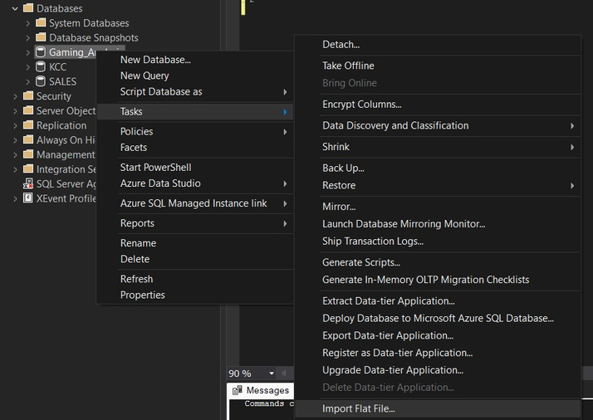
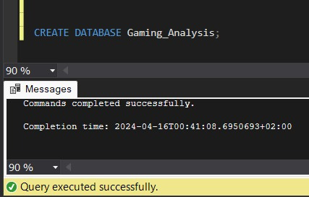
Import the Data
•
Create Database
•Import as flat file

Slide 6
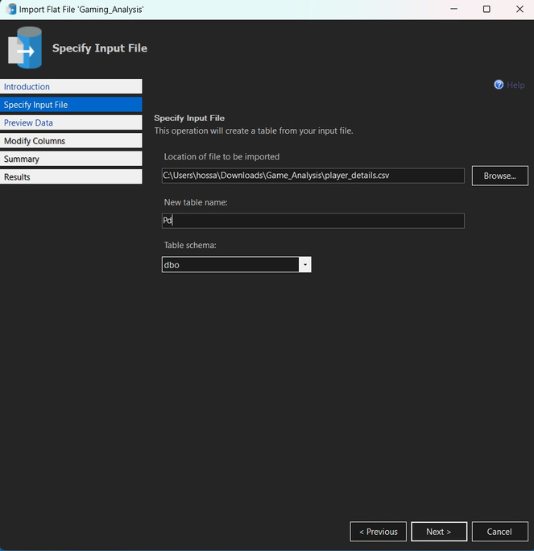
Import the Data
•
Browse the File

Slide 7
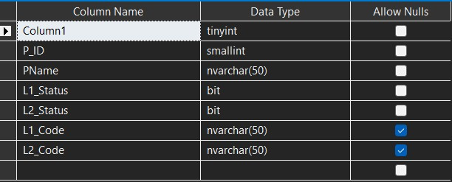
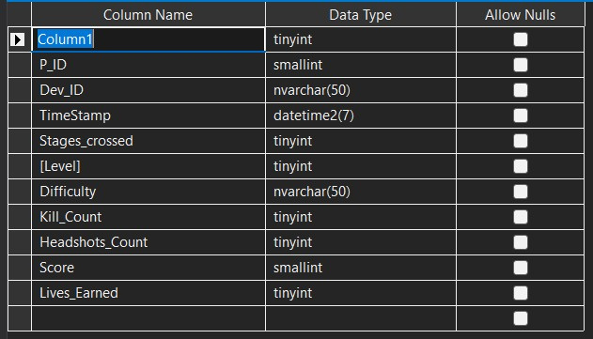
Prepare and Modify the Data
TASKS:
1.Delete Column1
2.Change Datatype for L1_Status and
L1_Status to varchar(30)
3.Change Datatype for P_ID to int primary
key
Tasks:
1.Delete Column1
2.Change Column name for TimeStamp to Start_datetime and datatype to datetime
3.Change Datatype for P_ID, Dev_ID, and
Start_datatime to primary key
4.Change Datatype for Dev_ID to
varchar(10)
5.Change Datatype for Difficulty to
varchar(15)

Slide 8
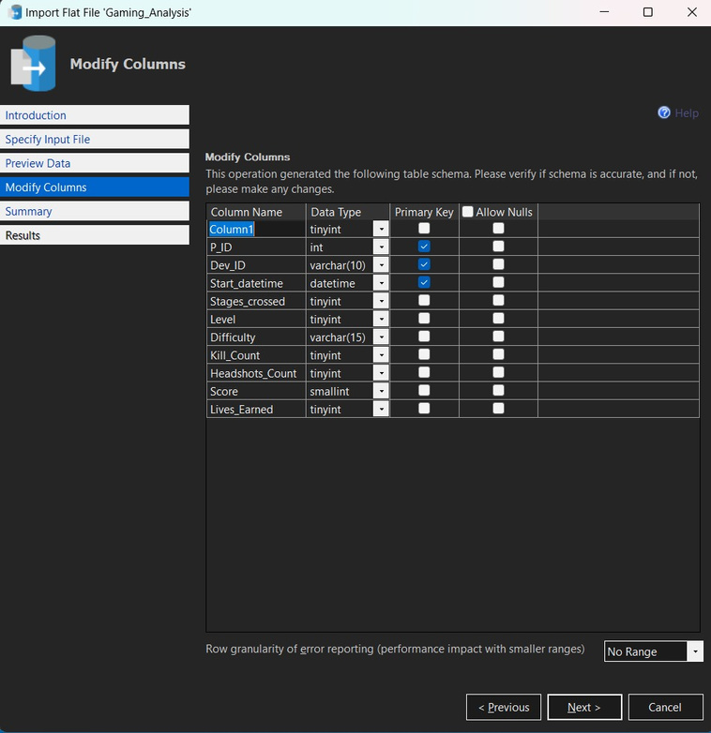
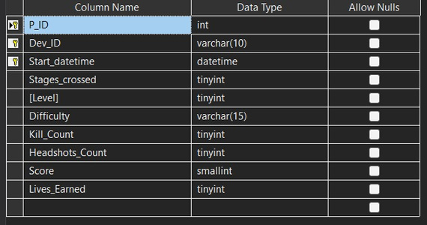
Modify the Data in Drop down menu

Slide 9
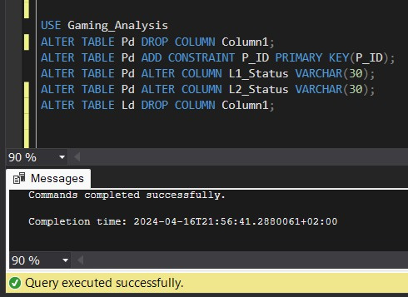
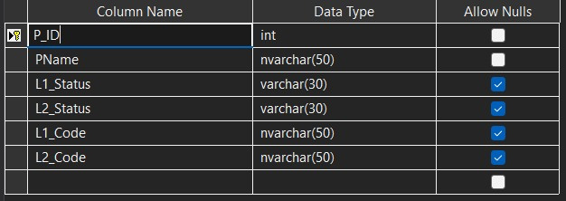
Modify the Data in SQL Queries

Slide 10

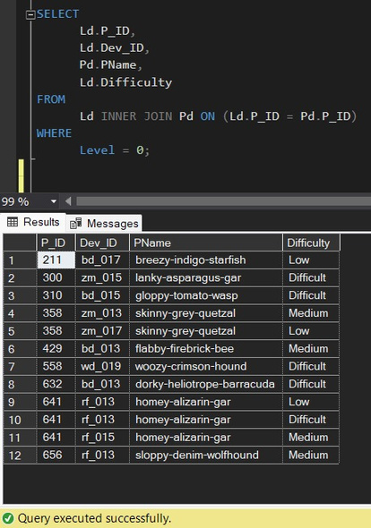
Analysis SQL Problem Statement
1) Extract ̀`P_ID`, ̀`Dev_ID`, `PName`, and `Difficulty_level` of all players at Level 0.

Slide 11
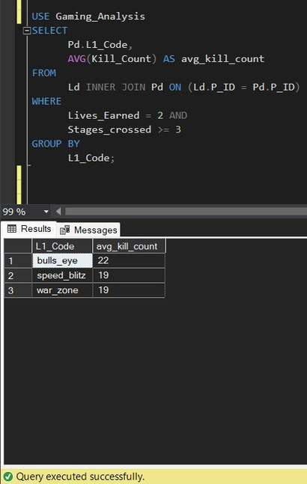
Analysis SQL Problem Statement
2) Find `Level1_code`wise average `Kill_Count` where `lives_earned` is 2, and at least 3 stages are crossed.

Slide 12
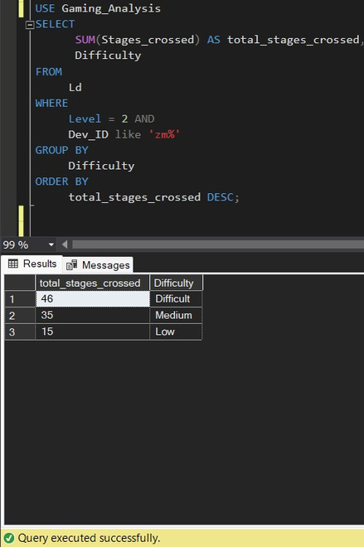
Analysis SQL Problem Statement
3) Find the total number of stages crossed at each difficulty level for Level 2 with players
using `zm_series` devices. Arrange the result in decreasing order of the total number of
stages crossed.

Slide 13
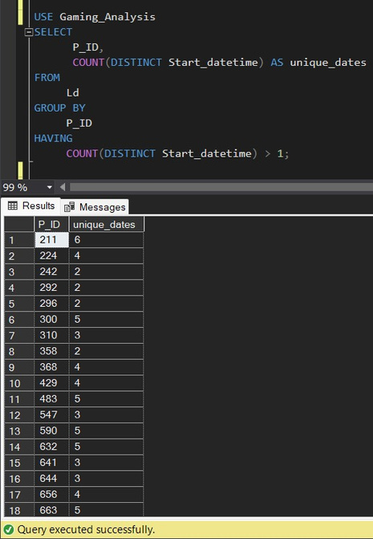
Analysis SQL Problem Statement
4) Extract ̀`P_ID` and the total number of unique dates for those players who have played
games on multiple days.

Slide 14
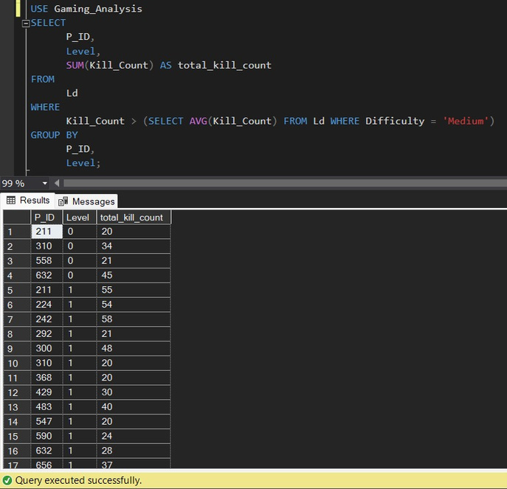
Analysis SQL Problem Statement
5) Find `P_ID` and levelwise sum of `kill_counts` where `kill_count` is greater than the average kill count for Medium difficulty.

Slide 15
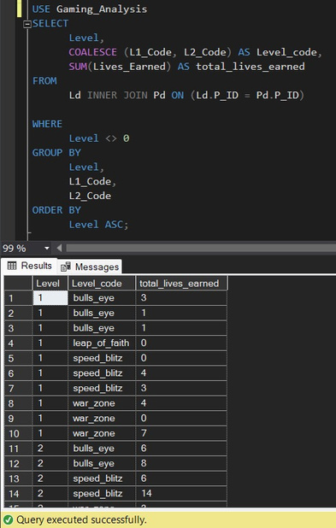
Analysis SQL Problem Statement
6) Find `Level` and its corresponding `Level_code`wise sum of lives earned, excluding Level 0. Arrange in ascending order of level.

Slide 16
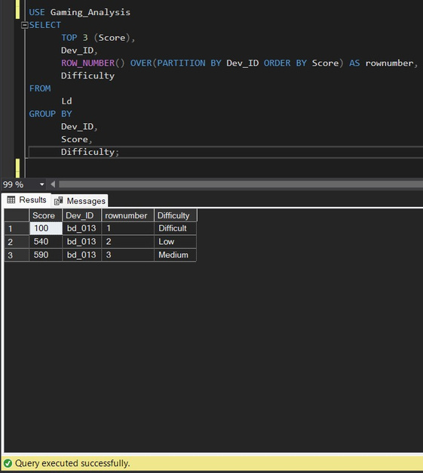
Analysis SQL Problem Statement
7) Find the top 3 scores based on each `Dev_ID` and rank them in increasing order using `Row_Number`. Display the difficulty as well.

Slide 17
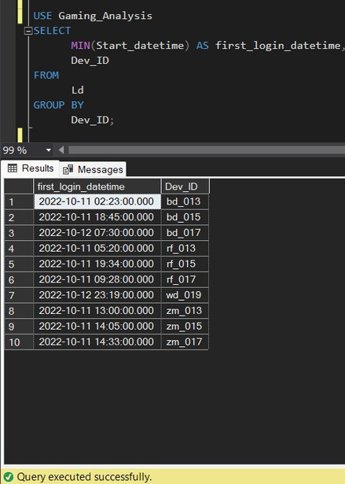
Analysis SQL Problem Statement
8) Find the ̀`first_login` datetime for each device ID.

Slide 18
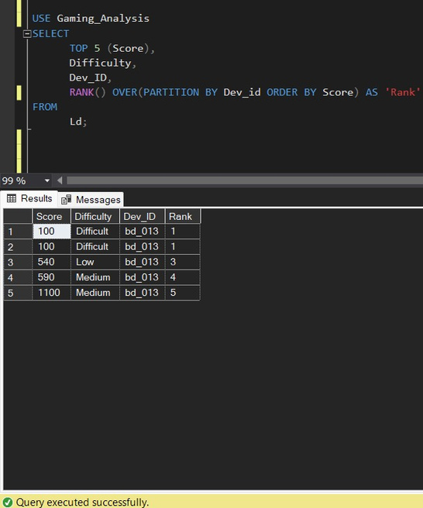
Analysis SQL Problem Statement
9) Find the top 5 scores based on each difficulty level and rank them in increasing order
using `Rank`. Display `Dev_ID` as well.

Slide 19
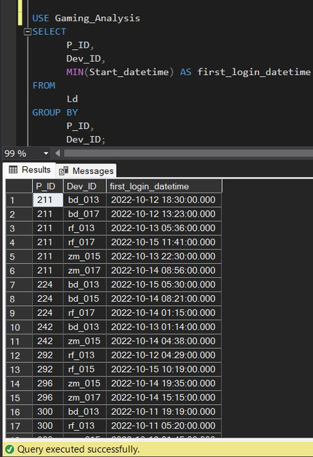
Analysis SQL Problem Statement
10) Find the device ID that is first logged in (based on ̀`start_datetime`) for each player (`P_ID`). Output should contain player ID, device ID, and first login datetime.

Slide 20
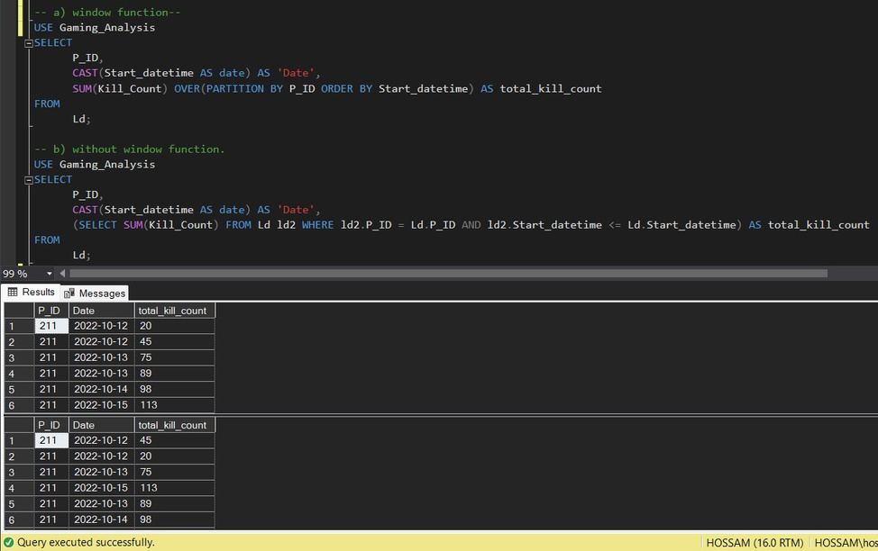
Analysis SQL Problem Statement
11) For each player and date, determine how many `kill_counts` were played by the player so far.
a) Using window functions
b) Without window functions

Slide 21
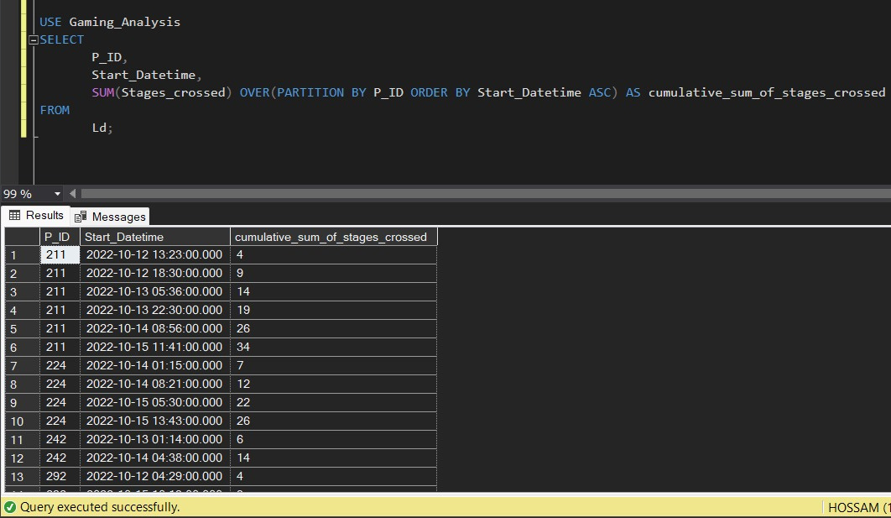
Analysis SQL Problem Statement
12) Find the cumulative sum of stages crossed over `start_datetime` for each `P_ID`, excluding t

Slide 22
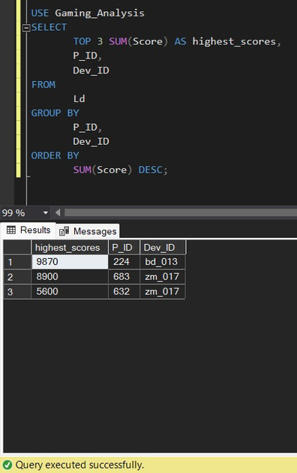
Analysis SQL Problem Statement
13) Extract the top 3 highest sums of scores for each `Dev_ID` and the corresponding `P_ID`.

Slide 23
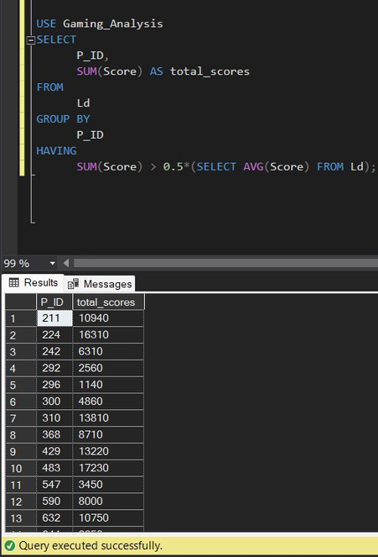
Analysis SQL Problem Statement
14) Find players who scored more than 50% of the average score, scored by the sum of scores for each `P_ID`.

Slide 24
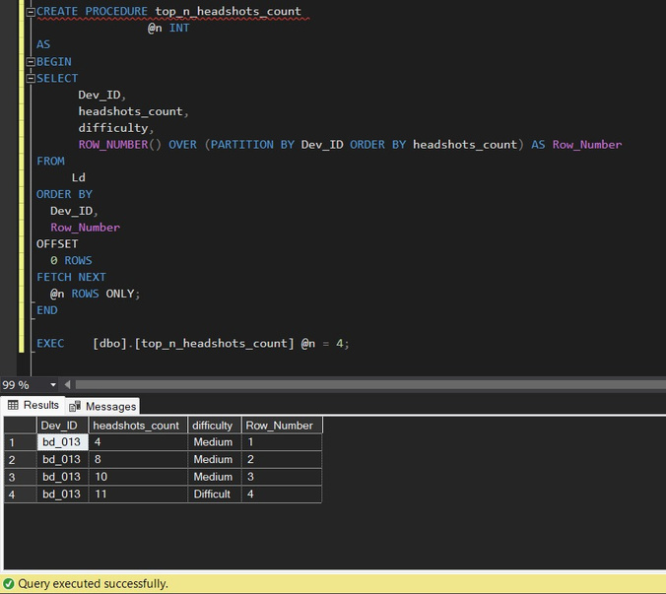
Analysis SQL Problem Statement
15) Create a stored procedure to find the top ̀`n` `headshots_count` based on each `Dev_ID`and rank them in increasing order using `Row_Number`. Display the difficulty as well.

Slide 25
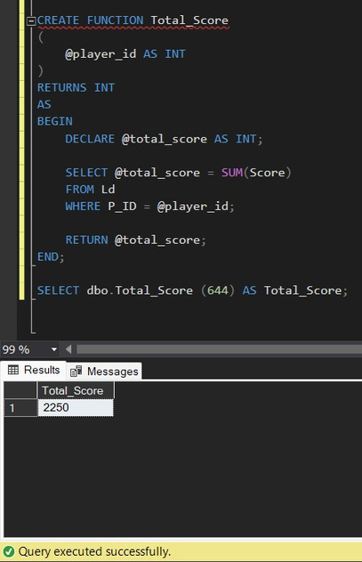
Analysis SQL Problem Statement
16) Create a function to return sum of Score for a given player_id.

Slide 26
What I learn
• • • • • • • •
SQL Joins
SQL GROUP BY and HAVING Clause A Nested Query
COALESCE and CAST Function
Row Number and Rank Function Minimum and Top Function
SQL Declare Variable OFFSET-FETCH clause

Slide 27

Thank You

